Slide 1
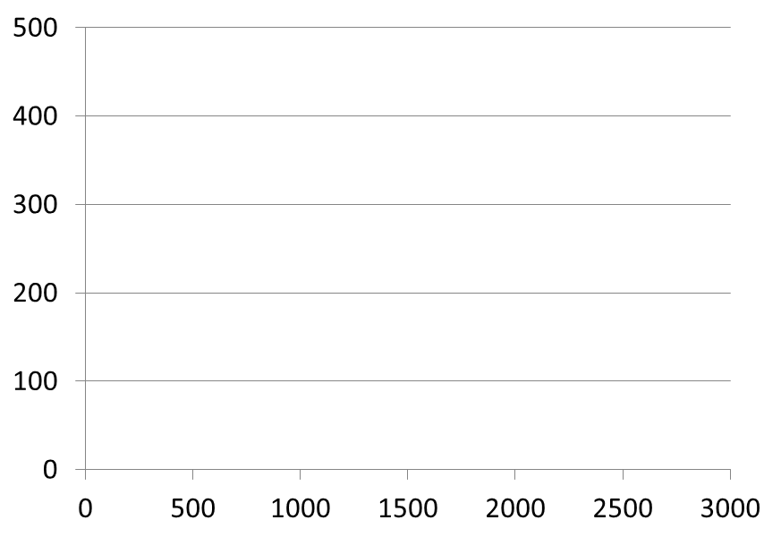
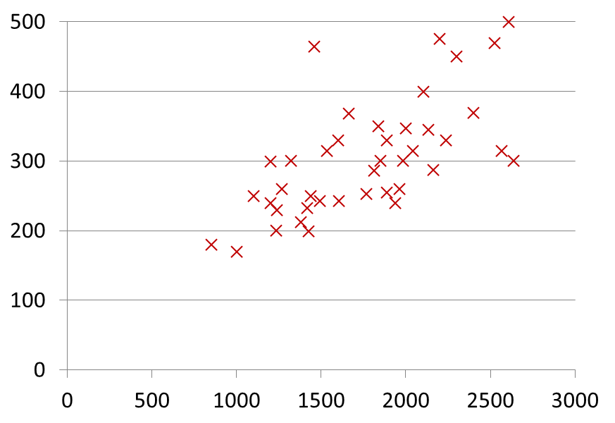
Reminder: sample problem
Housing Prices
(Portland, OR)
Price
(in 1000s of dollars)
Size (feet²)
CSC 4510 - M.A. Papalaskari - Villanova University

Slide 2
Reminder: Notation
Training set of
housing prices
(Portland, OR)
Size in feet² (x) | Price ($) in 1000's (y)
2104 | 460
1416 | 232
1534 | 315
852 | 178
… | …
Notation:
m = Number of training examples
x’s = “input” variable / features
y’s = “output” variable / “target” variable
CSC 4510 - M.A. Papalaskari - Villanova University

Slide 3
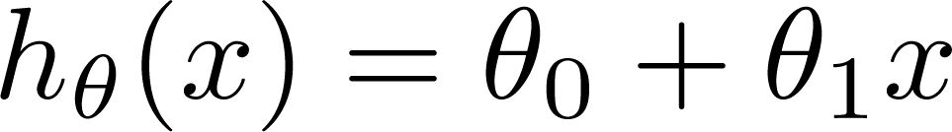
Reminder: Learning algorithm for hypothesis function h
Training Set
Learning Algorithm
Linear Hypothesis:
Size of house
h
Estimate price
Univariate linear regression)
CSC 4510 - M.A. Papalaskari - Villanova University

Slide 4
Reminder: Learning algorithm for hypothesis function h
Training Set
Learning Algorithm
Linear Hypothesis:
Size of house
h
Estimate price
Univariate linear regression)
CSC 4510 - M.A. Papalaskari - Villanova University

Slide 5
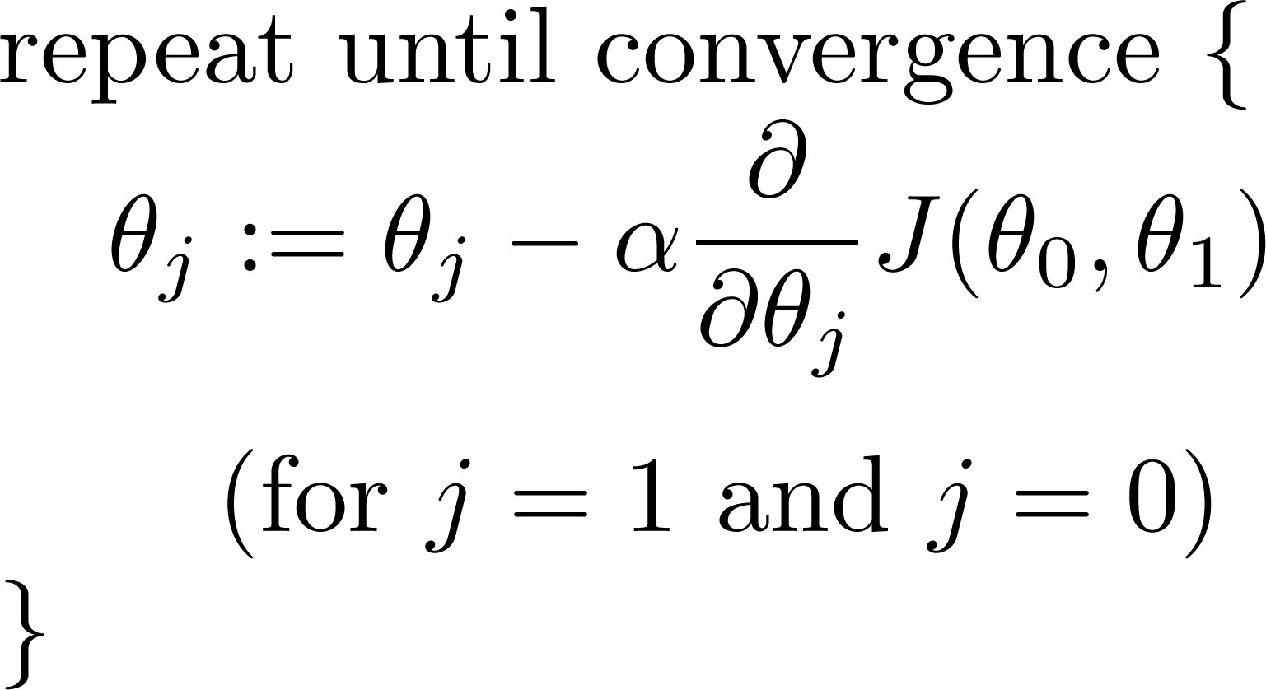
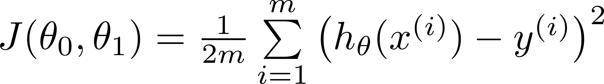
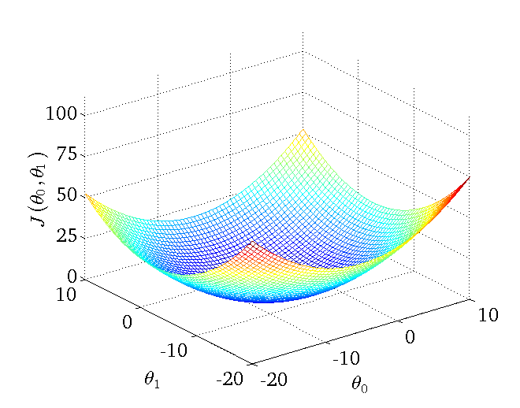
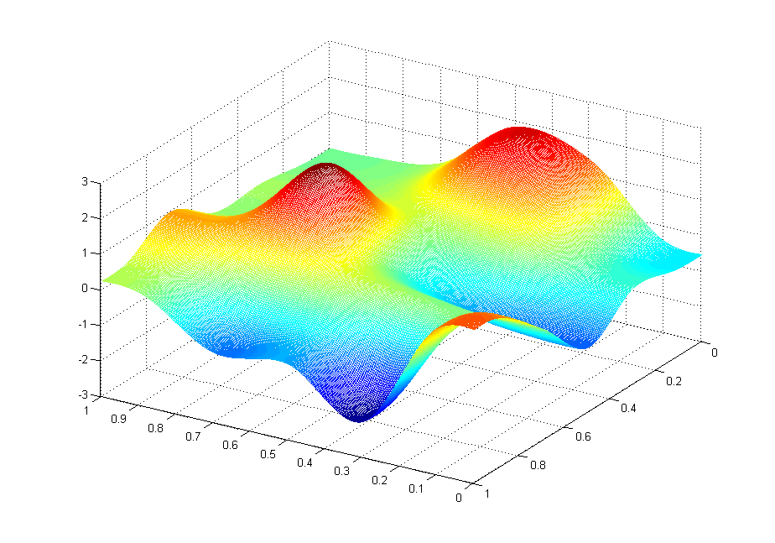
Gradient descent algorithm
Linear Regression Model
CSC 4510 - M.A. Papalaskari - Villanova University

Slide 6
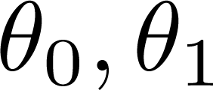
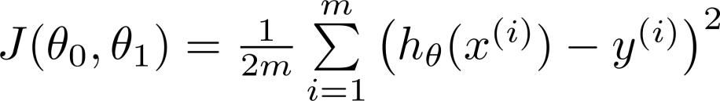
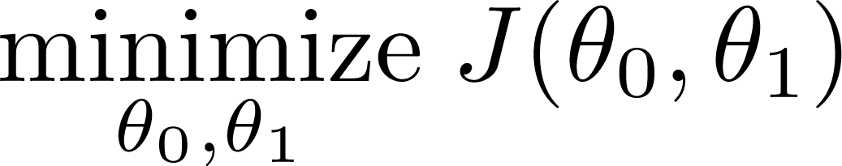
Hypothesis:
Parameters:
Cost Function:
Goal:
CSC 4510 - M.A. Papalaskari - Villanova University

Slide 7
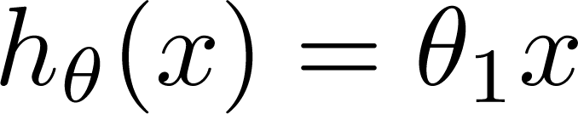

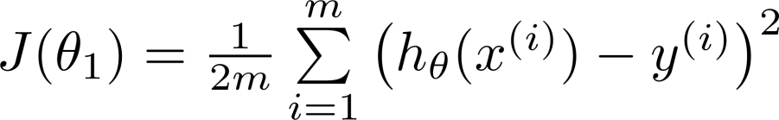
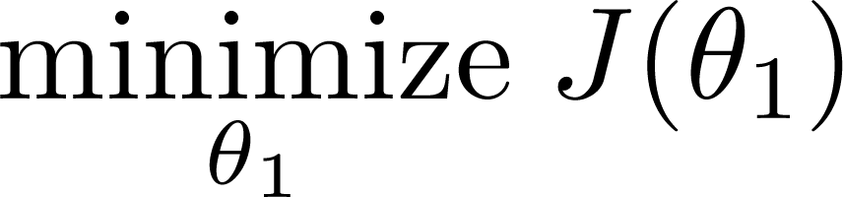
Simplified
θ₀ = 0
Hypothesis:
Parameters:
Cost Function:
Goal:
CSC 4510 - M.A. Papalaskari - Villanova University

Slide 8


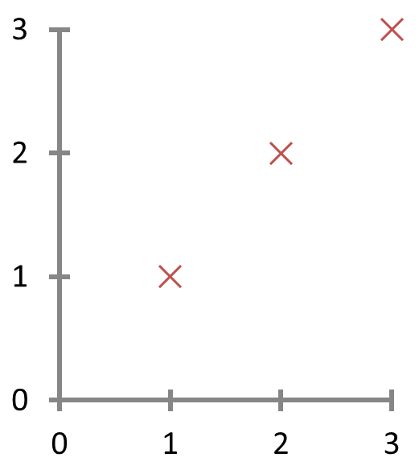
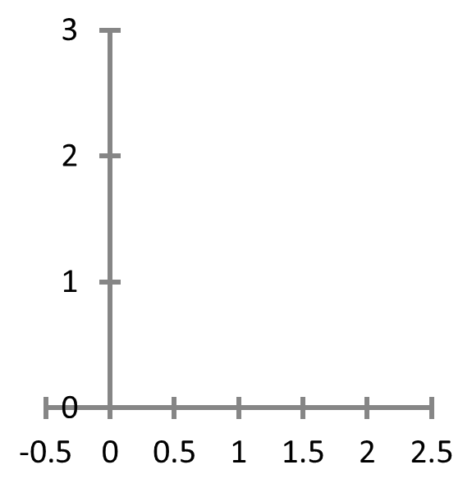




θ₀ = 0
(for fixed θ₁ this is a function of x)
(function of the parameter θ₁ )
y
x
h_{θ} (x) = x
CSC 4510 - M.A. Papalaskari - Villanova University

Slide 9

θ₀ = 0
(for fixed θ₁ this is a function of x)
(function of the parameter θ₁ )
y
x
h_{θ} (x) = 0.5x
CSC 4510 - M.A. Papalaskari - Villanova University

Slide 10

θ₀ = 0
(for fixed θ₁ this is a function of x)
(function of the parameter θ₁ )
y
x
h_{θ} (x) = 0
CSC 4510 - M.A. Papalaskari - Villanova University

Slide 11
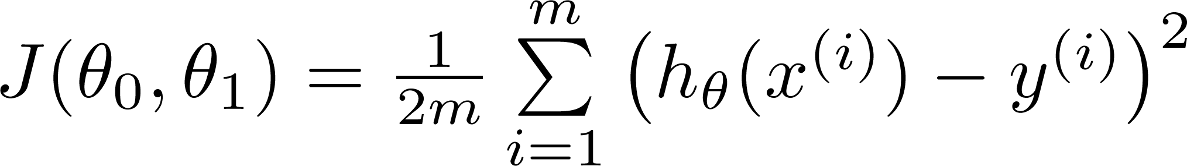
What if θ₀ ≠ 0?
Hypothesis:
Parameters:
Cost Function:
Goal:
CSC 4510 - M.A. Papalaskari - Villanova University

Slide 12
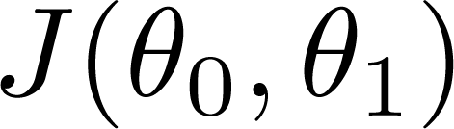
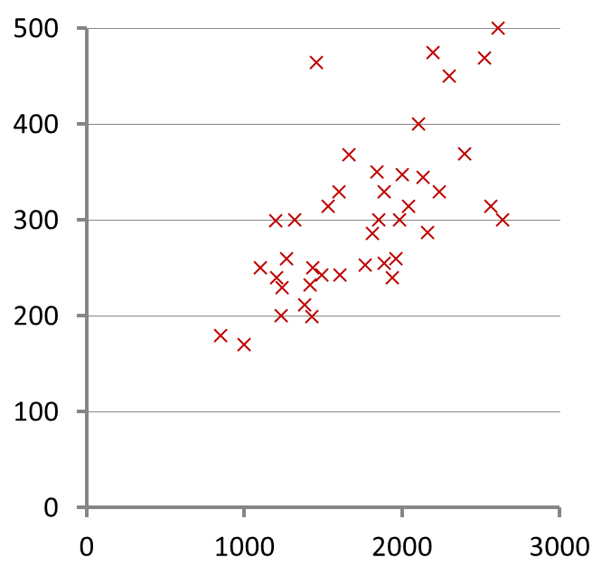
(for fixed θ₀ , θ₁ , this is a function of x)
(function of the parameters θ₀ , θ₁)
Price ($)
in 1000’s
Size in feet² (x)
h_{θ} (x) = 10 + 0.1x
CSC 4510 - M.A. Papalaskari - Villanova University

Slide 13
CSC 4510 - M.A. Papalaskari - Villanova University

Slide 14
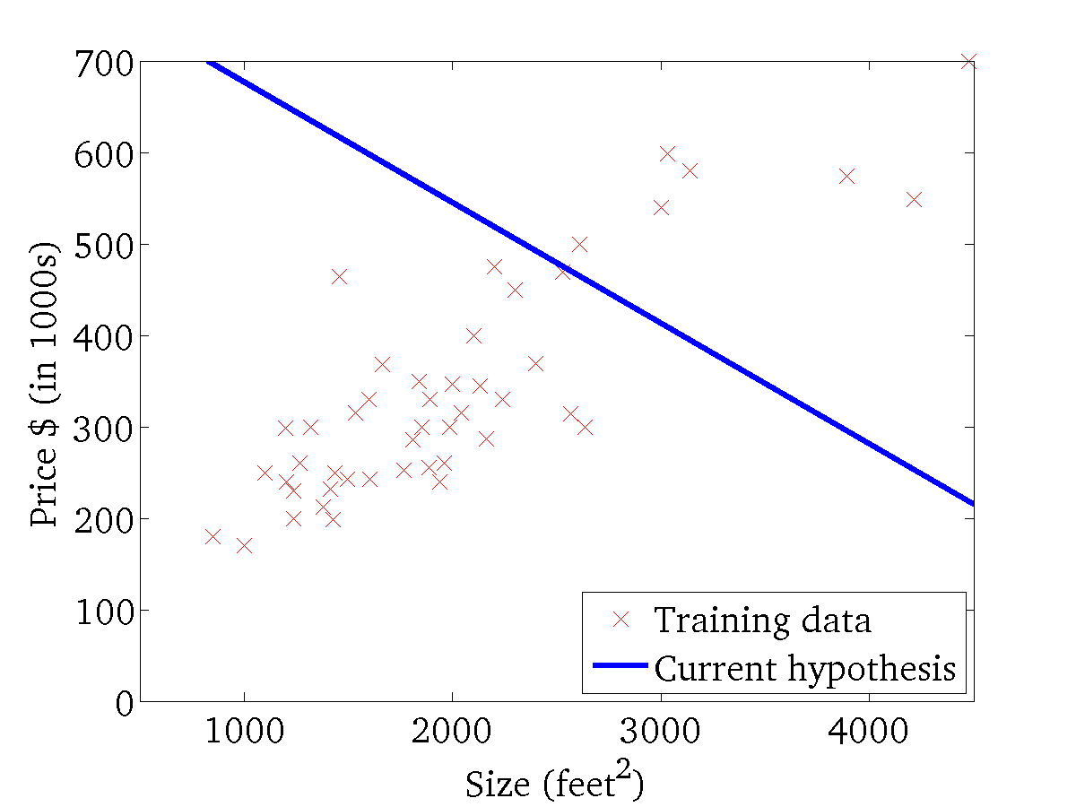
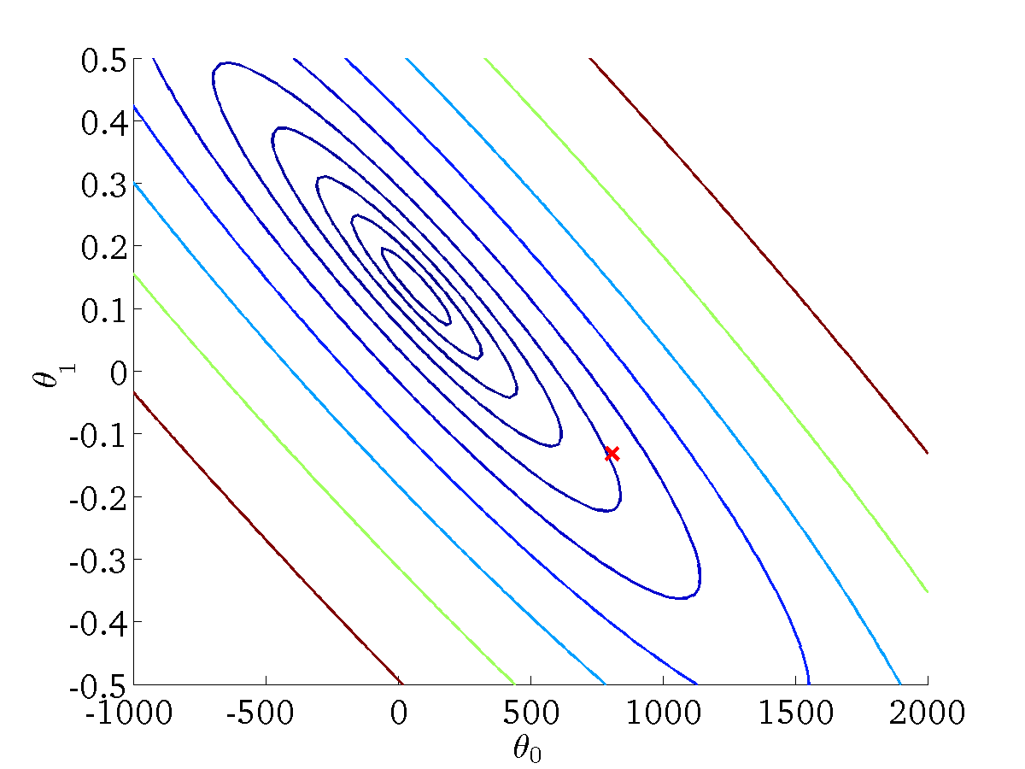
(for fixed θ₀ , θ₁ , this is a function of x)
(function of the parameters θ₀ , θ₁)
CSC 4510 - M.A. Papalaskari - Villanova University

Slide 15
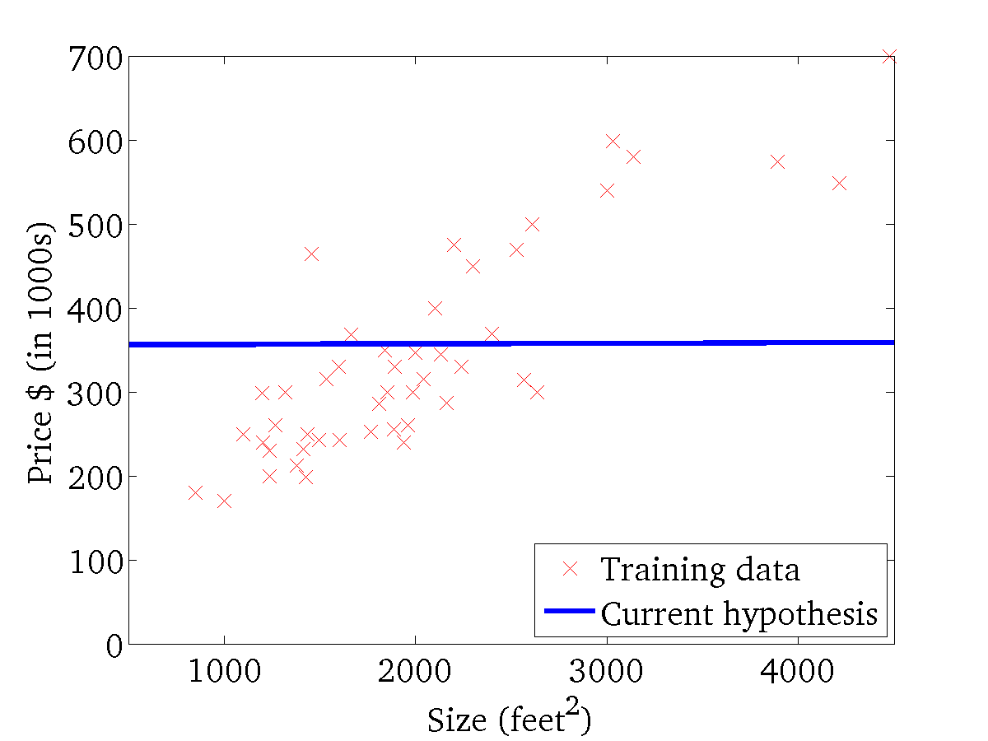
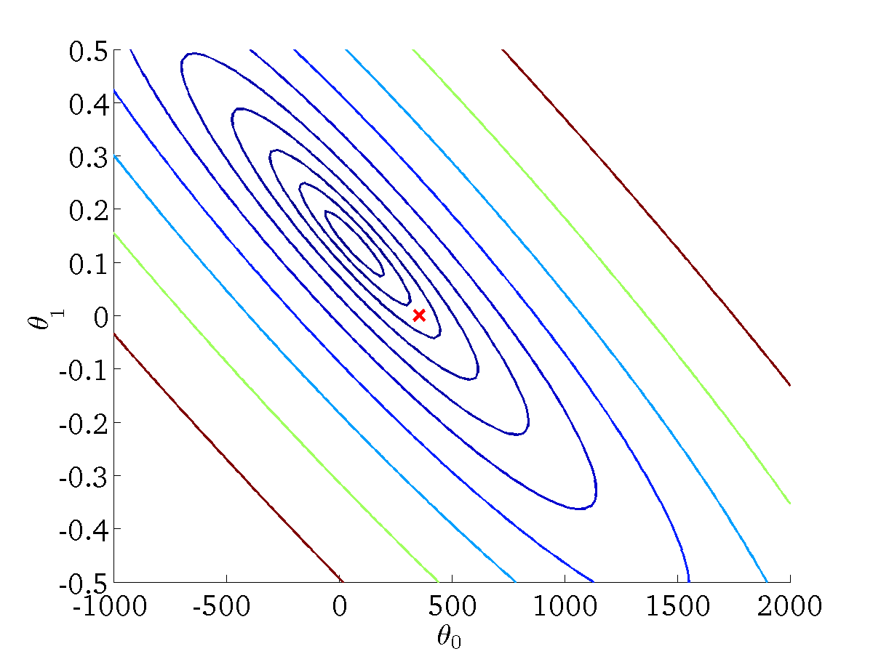
(for fixed θ₀ , θ₁ , this is a function of x)
(function of the parameters θ₀ , θ₁)
CSC 4510 - M.A. Papalaskari - Villanova University

Slide 16
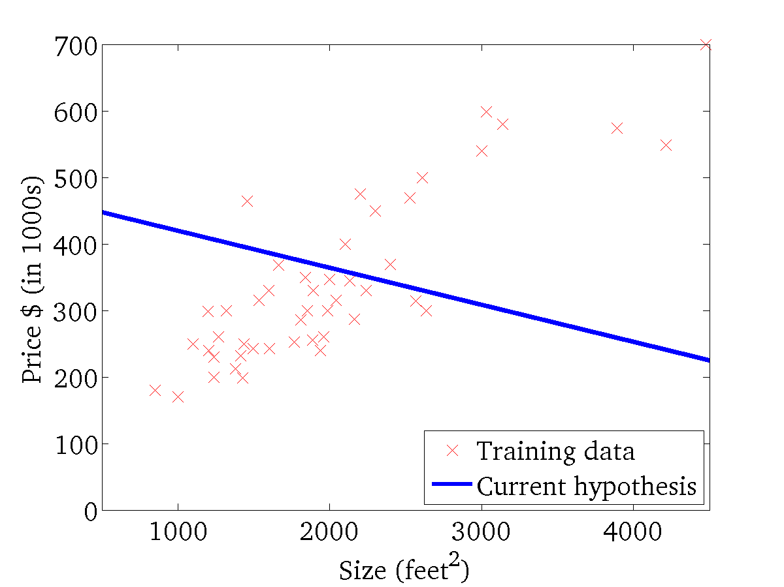

(for fixed θ₀ , θ₁ , this is a function of x)
(function of the parameters θ₀ , θ₁)
CSC 4510 - M.A. Papalaskari - Villanova University

Slide 17
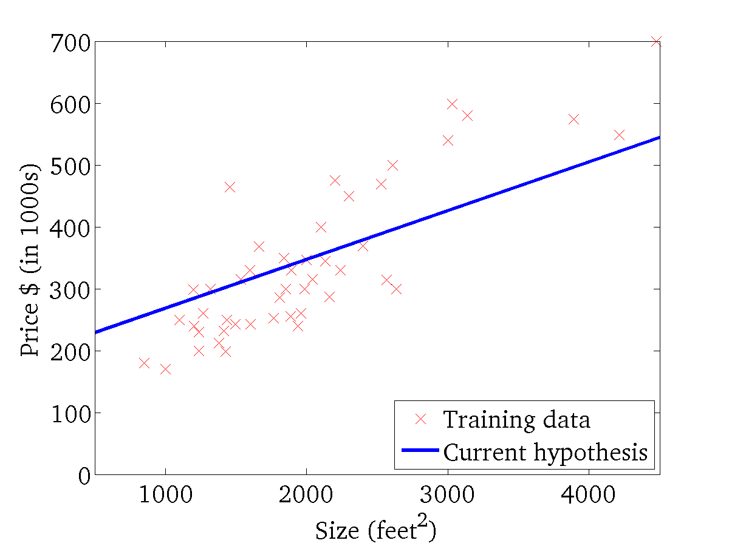
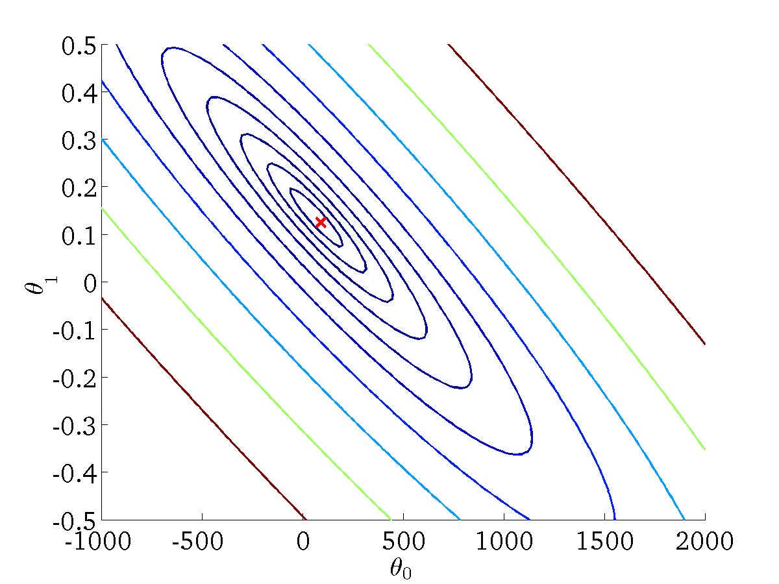
(for fixed θ₀ , θ₁ , this is a function of x)
(function of the parameters θ₀ , θ₁)
CSC 4510 - M.A. Papalaskari - Villanova University

Slide 18
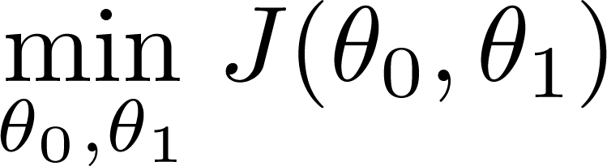
Have some function
Want
Gradient descent algorithm outline:
  Start with some
  Keep changing to reduce until we hopefully end up at a minimum
CSC 4510 - M.A. Papalaskari - Villanova University

Slide 19
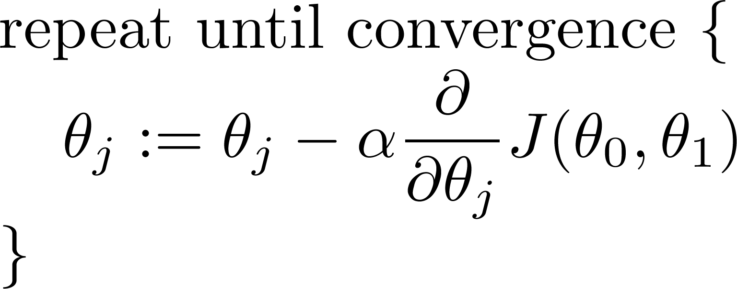
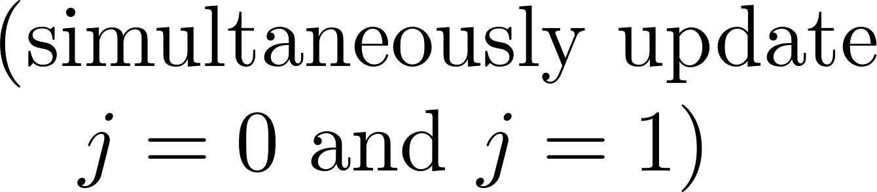
Have some function
Want
Gradient descent algorithm
CSC 4510 - M.A. Papalaskari - Villanova University

Slide 20
Have some function
Want
Gradient descent algorithm
learning rate
CSC 4510 - M.A. Papalaskari - Villanova University

Slide 21
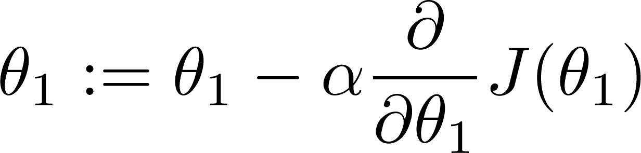
If α is too small, gradient descent can be slow.
If α is too large, gradient descent can overshoot the minimum. It may fail to converge, or even diverge.
CSC 4510 - M.A. Papalaskari - Villanova University

Slide 22

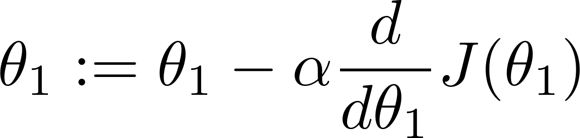
at local minimum
Current value of
CSC 4510 - M.A. Papalaskari - Villanova University

Slide 23
Gradient descent can converge to a local minimum, even with the learning rate α fixed.
CSC 4510 - M.A. Papalaskari - Villanova University

Slide 24
Gradient descent algorithm
Linear Regression Model
CSC 4510 - M.A. Papalaskari - Villanova University

Slide 25
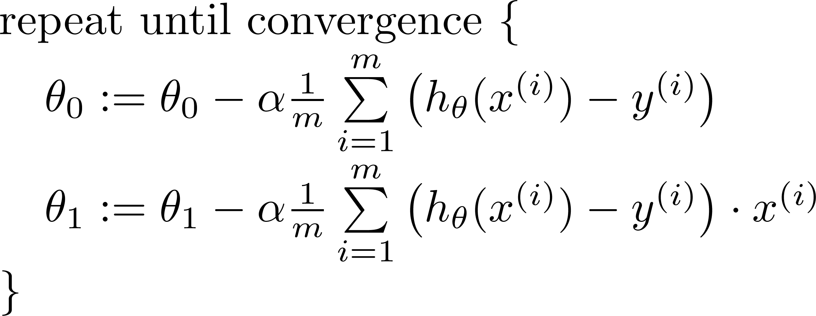

Gradient descent algorithm
update
and
simultaneously
CSC 4510 - M.A. Papalaskari - Villanova University

Slide 26
J(θ₀,θ₁)
θ₁
θ₀
CSC 4510 - M.A. Papalaskari - Villanova University

Slide 27
J(θ₀,θ₁)
θ₁
θ₀
CSC 4510 - M.A. Papalaskari - Villanova University

Slide 28
CSC 4510 - M.A. Papalaskari - Villanova University

Slide 29


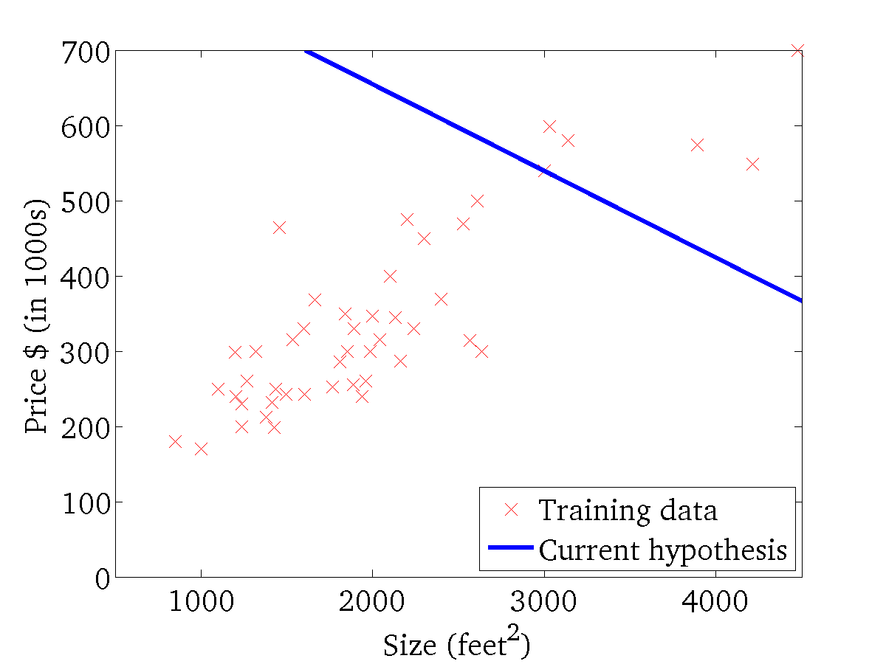
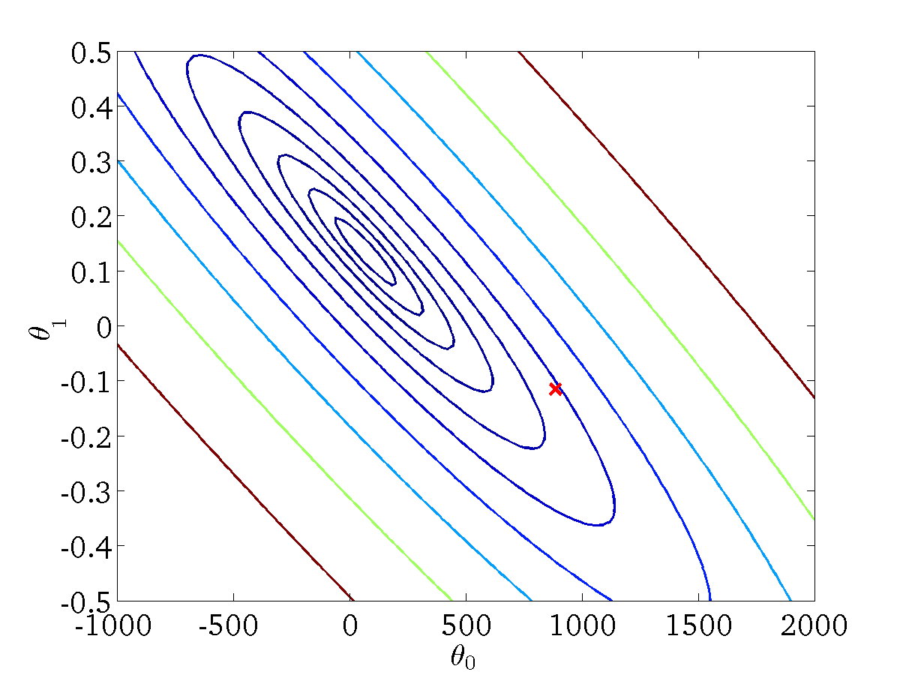
(for fixed , this is a function of x)
(function of the parameters )
CSC 4510 - M.A. Papalaskari - Villanova University

Slide 30

(for fixed , this is a function of x)
(function of the parameters )
CSC 4510 - M.A. Papalaskari - Villanova University

Slide 31
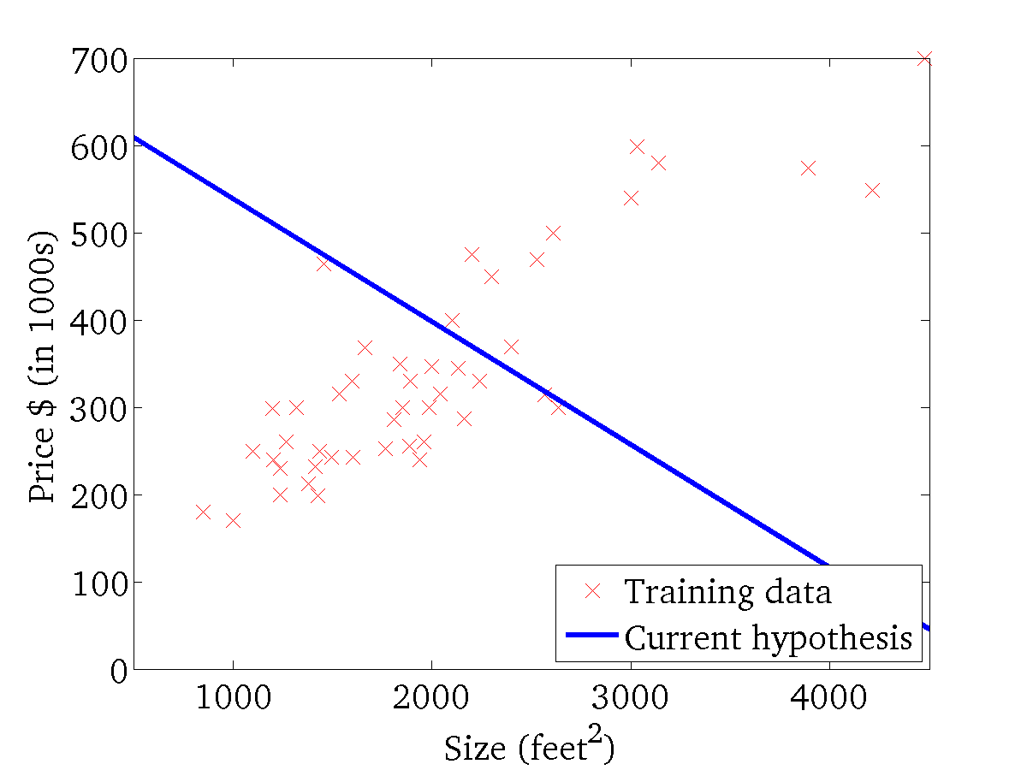
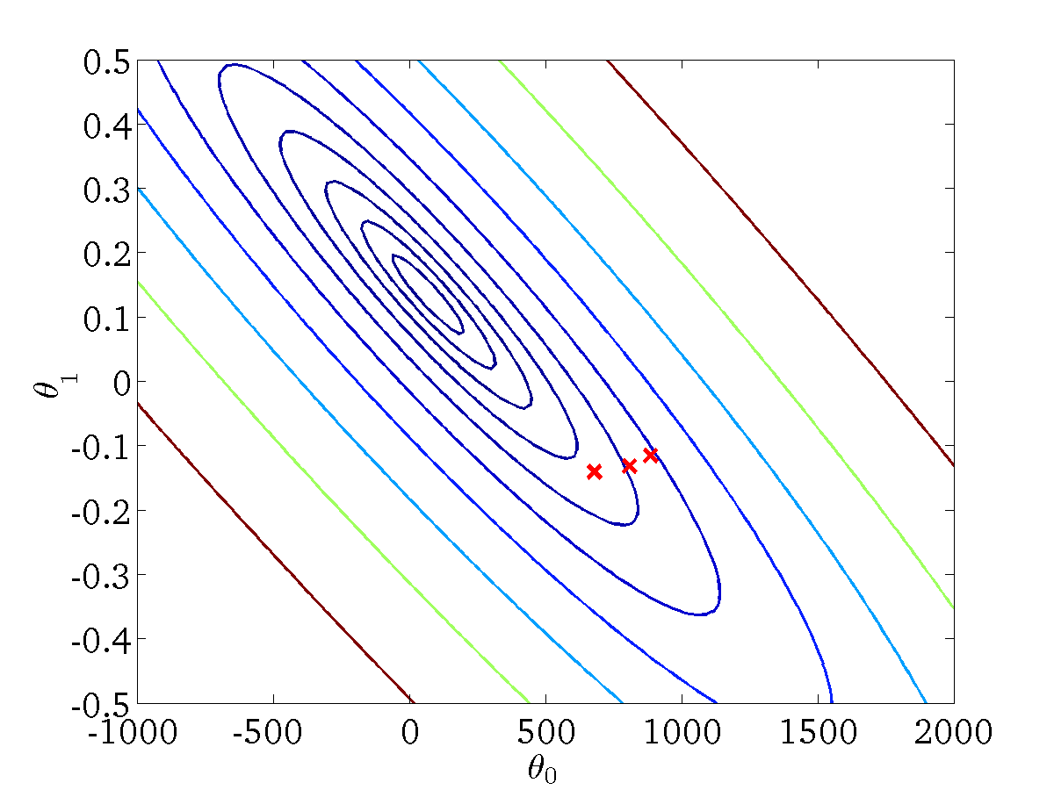
(for fixed , this is a function of x)
(function of the parameters )
CSC 4510 - M.A. Papalaskari - Villanova University

Slide 32
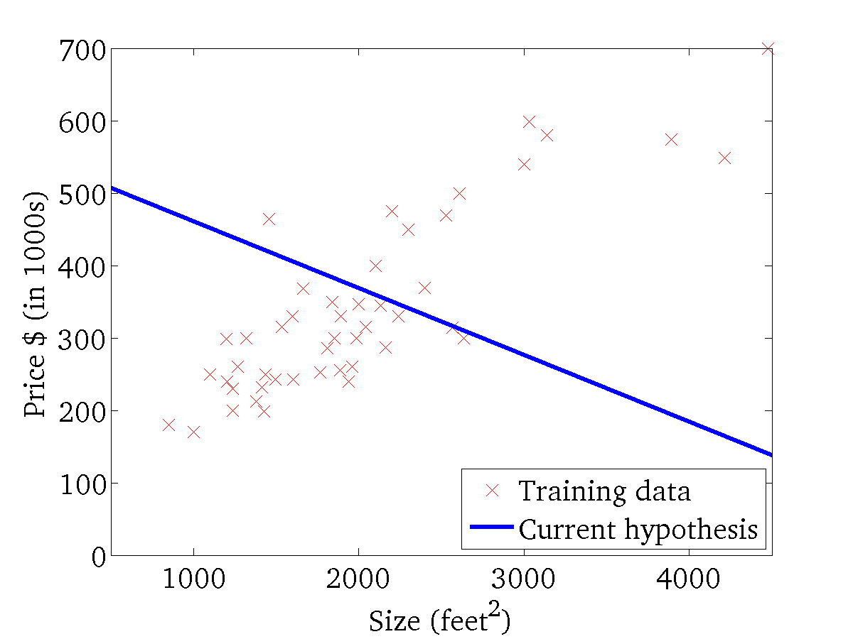

(for fixed , this is a function of x)
(function of the parameters )
CSC 4510 - M.A. Papalaskari - Villanova University

Slide 33
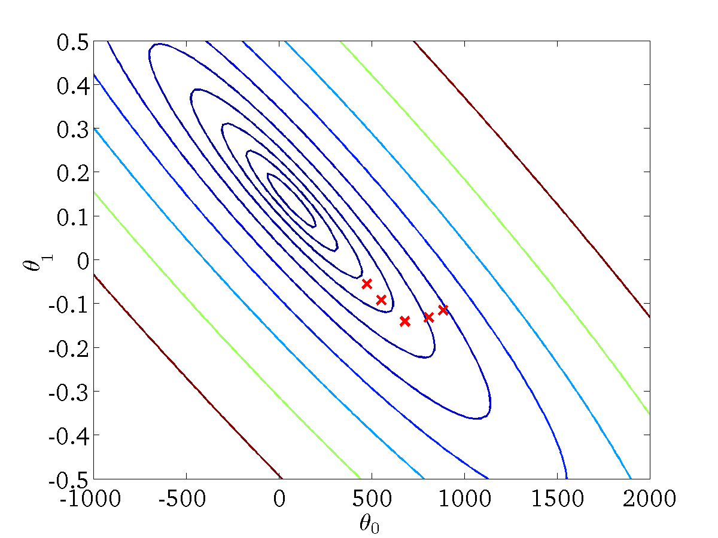
(for fixed , this is a function of x)
(function of the parameters )
CSC 4510 - M.A. Papalaskari - Villanova University

Slide 34

(for fixed , this is a function of x)
(function of the parameters )
CSC 4510 - M.A. Papalaskari - Villanova University

Slide 35
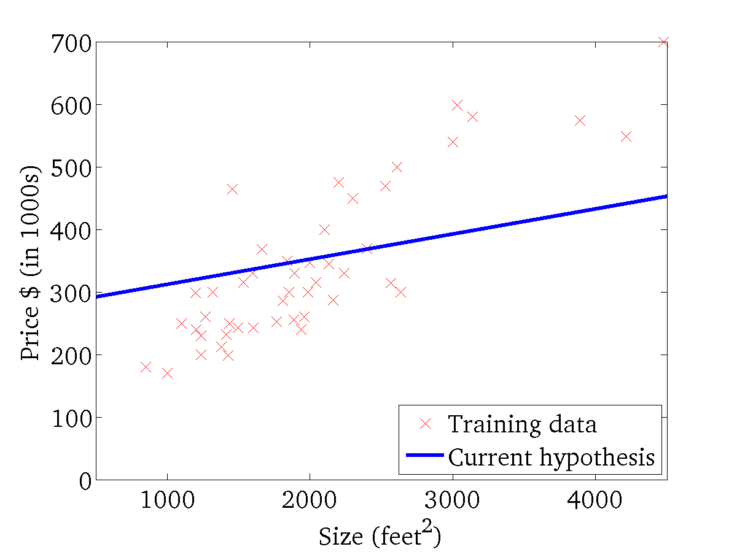

(for fixed , this is a function of x)
(function of the parameters )
CSC 4510 - M.A. Papalaskari - Villanova University

Slide 36
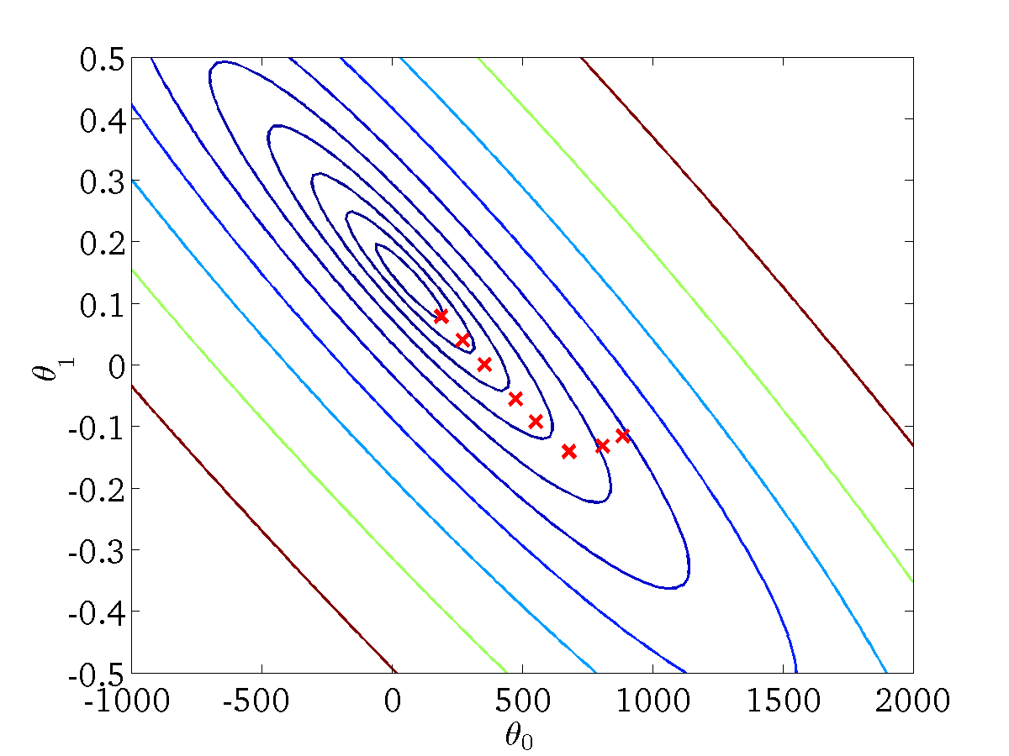
(for fixed , this is a function of x)
(function of the parameters )
CSC 4510 - M.A. Papalaskari - Villanova University

Slide 37
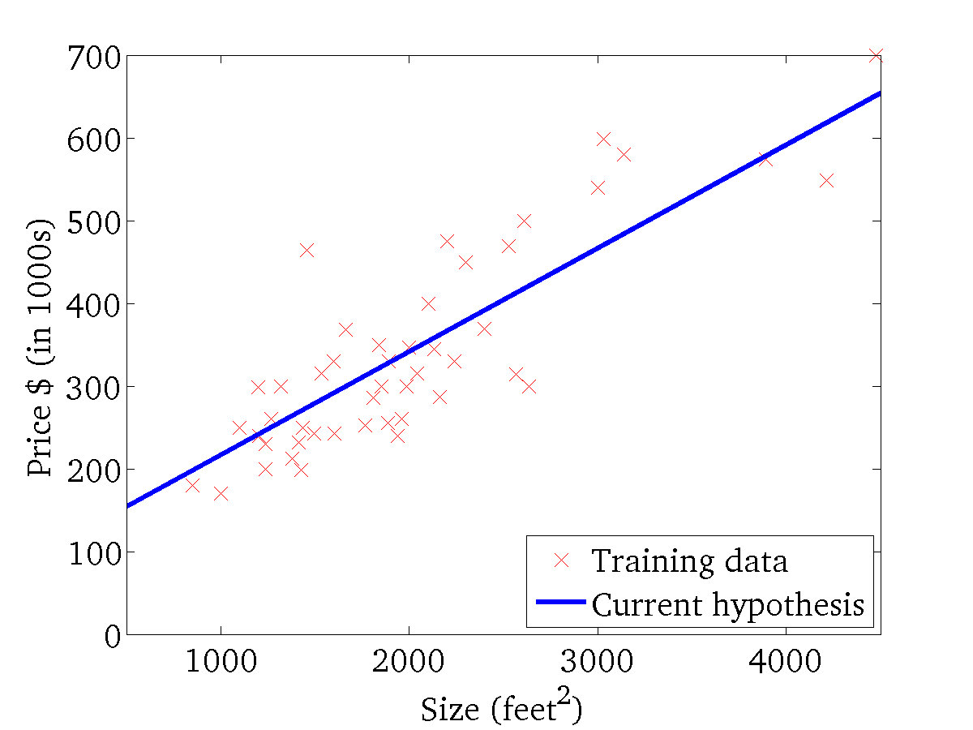

(for fixed , this is a function of x)
(function of the parameters )
CSC 4510 - M.A. Papalaskari - Villanova University

